Slide 1
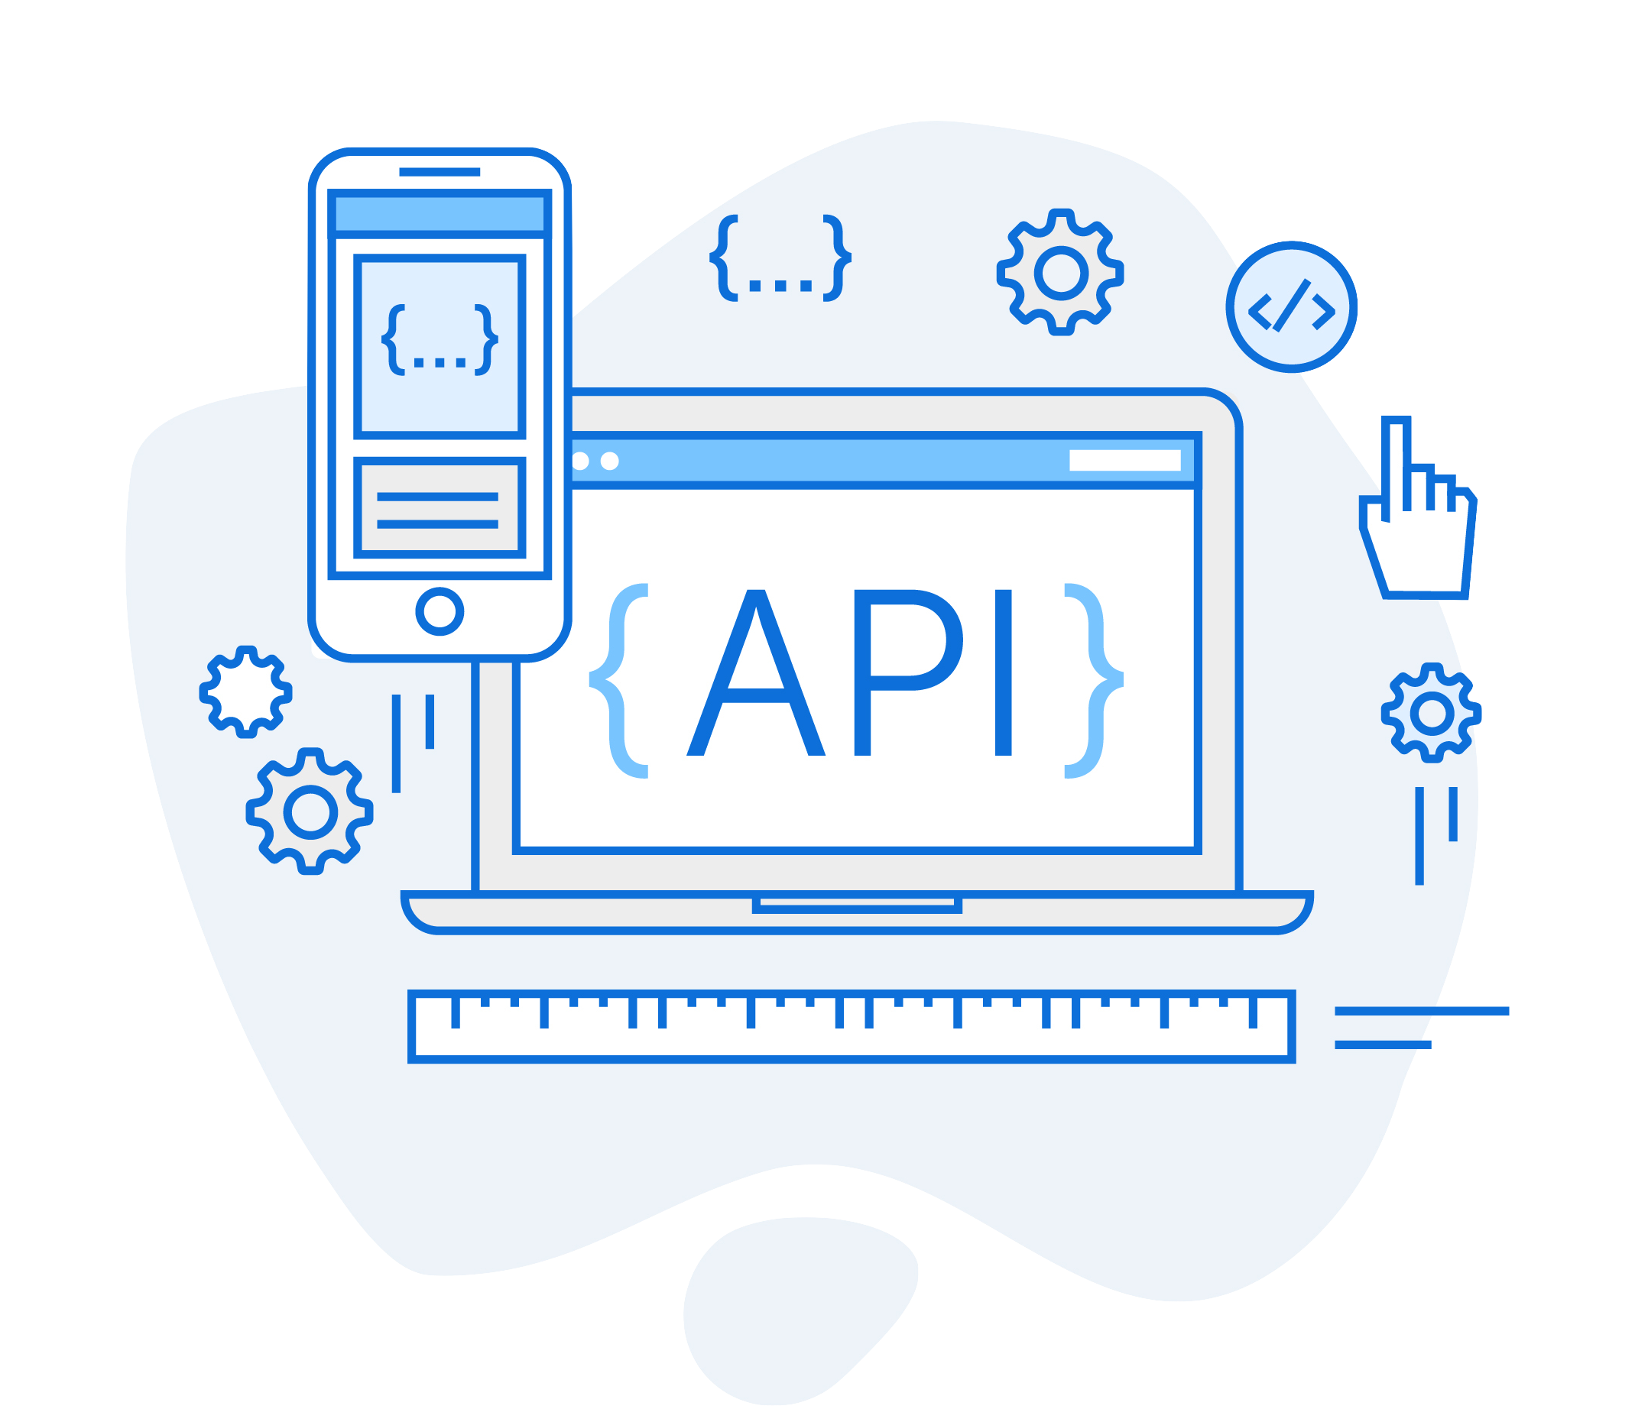
REST API
Amir Jamal
Atar Saadi

Slide 2
What is an API?
An API is a set of definitions and protocols for building and integrating application software. API stands for application programming interface.
APIs let your product or service communicate with other products and services without having to know how they’re implemented.

Slide 3
What is an API?
router.get("/expenses", function (request, response) {
Expense.find({})
.sort({ date: -1 })
.exec(function (err, expenses) {
console.log(expenses)
response.send(expenses)
})
})
router.delete(“/expense", function (request, response) {
// This Route save an expense
})

Slide 4
Background
Creating a server has no binding restriction between the route name and the executed code and no restriction on the type of data we send.

Slide 5

Single Page Web Apps
Mobile Apps
Service API
Frontend UI is decoupled from the backend

Slide 6
What is a REST API?
REST stands for Representational State Transfer.
It is an architectural Style for designing networked applications. It is the most popular style for building web APIs. REST determines specifications of the API through a set of rules that are followed when a REST API is created.

Slide 7
REST API
Transfer data instead of User interfaces

Slide 8
How to use REST APIs?
With REST APIs, we usually send HTTP requests like GET, PUT, or POST (and more).

Slide 9

REST API Architecture
Database
GET/ POST/ PUT/ DELETE
Client
{…}
JSON / XML
REST API

Slide 10
Data Format
HTML
Plain Text
XML
JSON
<name>text</nam>
<p>text<p>
text
{“content”:”text”}
Data & Structure
Data
Data
Data
Contains UI
No UI Assumptions
No UI Assumptions
No UI Assumptions
Not difficult to parse , no structure
Machine-readable , XML parser needed
Machine-readable and concise , can be easily converted
Not difficult to parse

Slide 11
Purpose Of Rest API
Rest api can ease the communications , means calls will be messaged based and reliate on the http standards to describe these messages GET/POST/PUT/DELETE .
Allows building an infrastructure for our server organization, using uniform interface that creates transparency.
Statelessness is about making sure that calls to the API aren't tied to a particular server, which increases the likelihood of building scalable server infrastructures.

Slide 12
Principles of Designing RESTful APIs
keep it simple
Use nouns, not verbs
Use of the right HTTP methods
Use plurals
Use parameters
Use proper HTTP codes
Versioning
Use pagination
Supported formats

